Slide 1
Expert Group Digitalisation
Working Paper
Nina Knops
German Academic Exchange Service (DAAD)

Slide 2
Expert Group Digitalisation
Digitalisation was introduced as transversal priority at ASEMME7 (2019)
Establishment of EG Digitalisation in December 2019
Coordinated by DAAD
4 meetings between ASEMME7 and ASEMME8
Output: Working Paper on the digital transformation in education

Slide 3
Working Paper
Digital infrastructure
International exchange and mobility
Futures of (lifelong) learning
Quality assurance and recognition
Objective of the paper
looks at challenges and opportunities of digitally enhanced education
provides key messages to ASEM policymakers

Slide 4
Digital transformation in the ASEM context
“The members of the ASEM EG Digitalisation consider it fundamental that the digital transformation in education is inclusive, human-centred, sustainable and transparent. Digitally enhanced education shall be accessible, flexible and tailored to the individual needs of a learner (learner-centred) stimulating learning throughout life. Further, it shall be of high quality as well as serve as an instrument to improve the quality of life of a learner. Digitally enhanced learning within the ASEM Education Process shall offer collaboration and virtual exchange, creating opportunities for learners everywhere to collectively work on global challenges.”

Slide 5
Digital infrastructure
Investing in equal access to internet, technological devices and digital skills
Promoting interoperability of digital platforms and systems
Fostering joint research on technology frameworks for education

Slide 6
International exchange and mobility
Facilitating better exchange of data among institutions and digitising data mobility
Facilitating that learners can “own” their individual learner data
Promoting Collaborative Online International Learning (COIL)/ virtual exchange

Slide 7
Futures of (lifelong) learning
Promoting digital competences of teachers and learners
Investing in teacher training to use digital tools for pedagogy
Coordinating education policies with digital connectivity and social policies in order to facilitate inclusive lifelong learning
Facilitating the availability of high-quality Open Educational Resources (OER)

Slide 8
Quality assurance and recognition
Integrating online learning offers by educational providers into existing quality assurance approaches
Facilitating that learners can move between different types of providers (between HE and TVET)
Promoting exchange on the use of NQFs, RQFs, the World Reference Levels, UNESCO’s Global Convention on Recognition etc. to include, make transparent and recognise micro-credentials

Slide 9
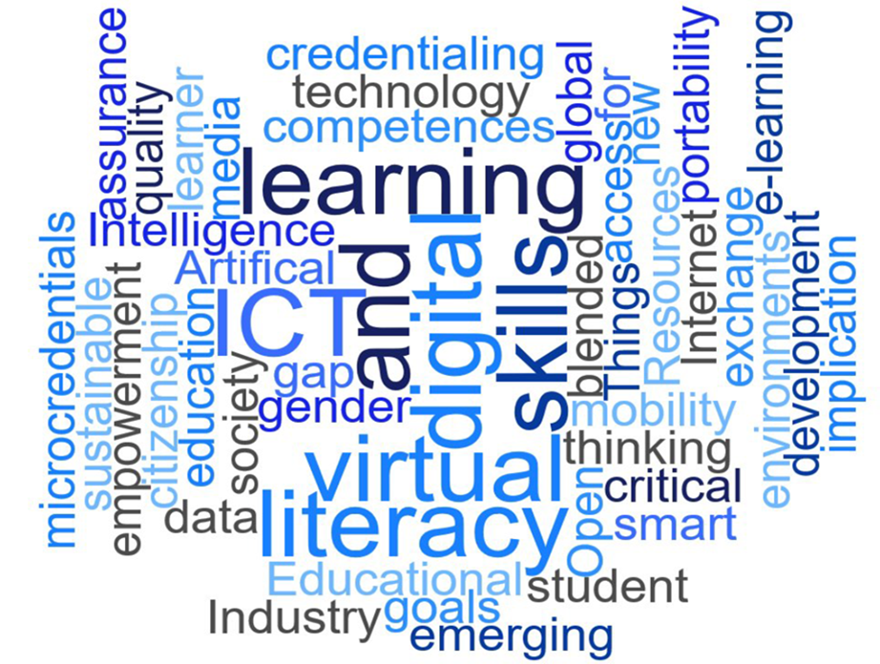
Thank you for your attention!

Slide 10


