Slide 1
ASEM Education Senior Officials’ Meeting
Teerakiat Jareonsettasin, MD, MRCPsych
Former Minister of Education, Thailand

Slide 2
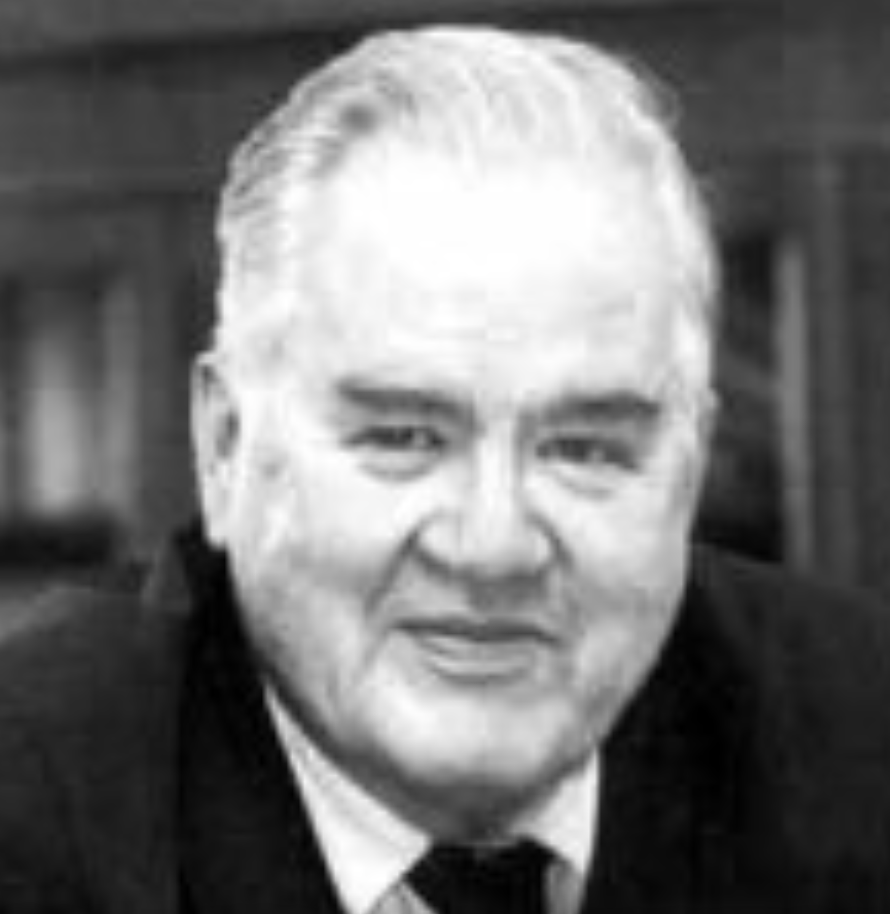

Slide 3
Education must be complete, meeting all the demands that human nature brings with it. Its aim is to realise the harmonious and complete man, whose completeness is found in service of the community. Education of character must precede any instruction in particular businesses.
Michael Oakeshott

Slide 4
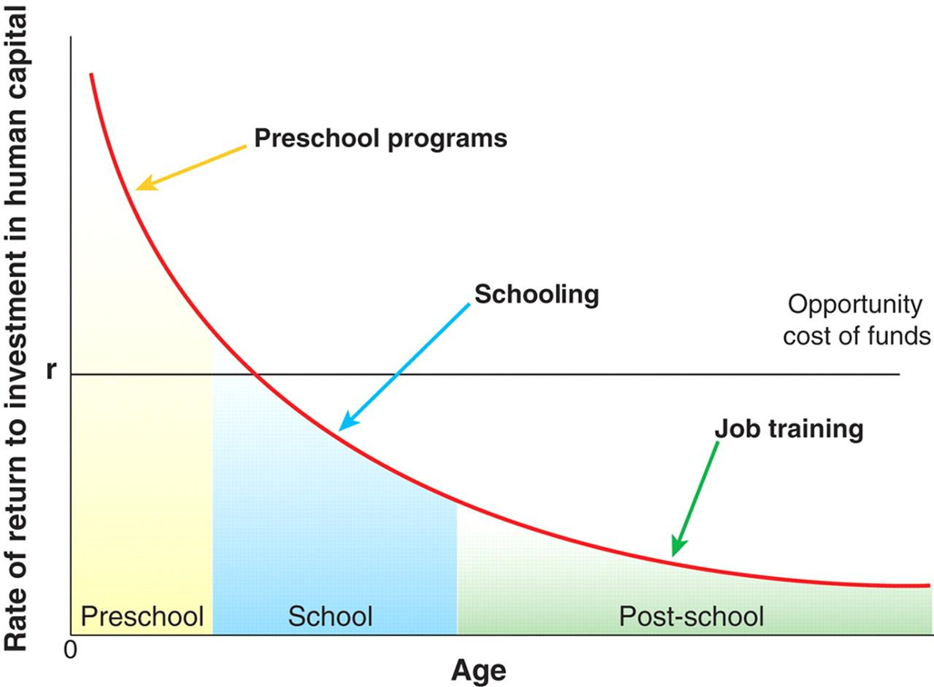
Priority for Educational Investment
Source: Heckman, James J. 2006. “Skill Formation and the Economics of Investing in Disadvantaged Children.”

Slide 5
Challenges to Education
Pandemics
Climate change
Terrorism
Leadership

Slide 6
Leadership Crisis
“Too many directives, no direction”.
- Lord Sainsbury of Turville

Slide 7
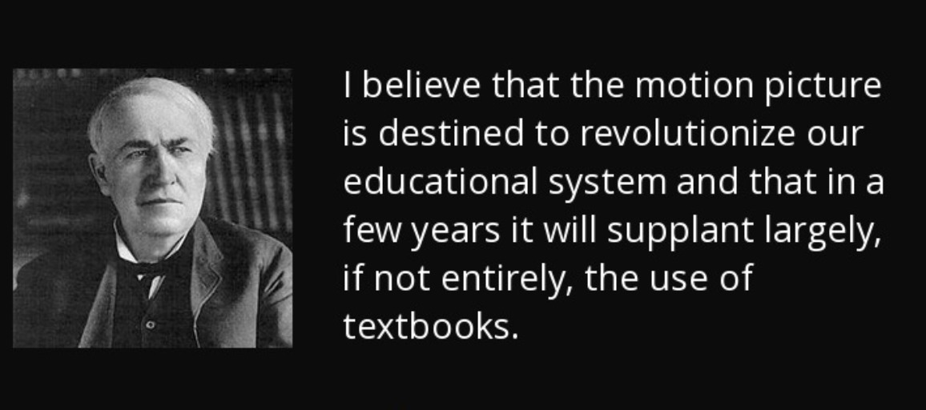

Slide 8
