Slide 1
Compendium Online tool
Expert group on Interregional Credit Transfer Mechanisms and Learning Outcome Systems
Phuket
28 March 2019

Slide 2
ASEM Education Online Compendium on iCTS&LOS
Compendium online tool
What has been decided (and discussed with web developers)
  Geographical approach (map);
  Internal Search engine (language);
  User-friendly and related to target group (professionals);
  Regular updates and follow-ups of the data-base;
  A holistic overview but also compare data;
  Terms of glossary highlighted.

Slide 3
ASEM Education Online Compendium on iCTS&LOS
Compendium online tool
Challenges
  Technically complex (back-end / front-end);
    Back-end: data base used to be updated and configurated by AES;
    Front-end: website designed for professionals of HE(I).
  Tool needs updates and must support changing templates;
  Investment in terms of
    Money;
    Time;
    and workforce.

Slide 4
ASEM Education Online Compendium on iCTS&LOS
Compendium online tool
State of play
  Project definition (web developers);
  Public market launched including an official bid;
  Public market has been attributed;
  Back-end is ready;
  Starting copy-pasting content of templates into the tool next week
    Adaption of some templates;
    Trainee (Ophélie);
  After Eastern (23th April) starting tests with front-ends;
    Asking for feedback
    Name of domain

Slide 5
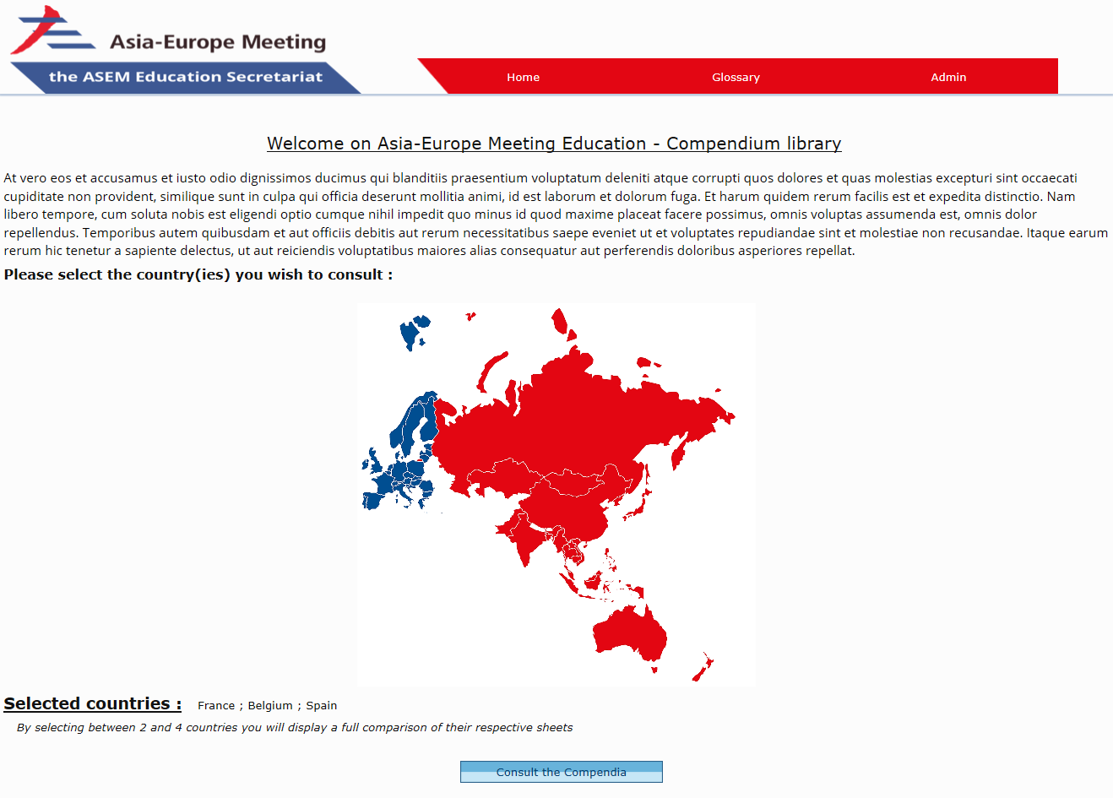
Compendium online tool

Slide 6
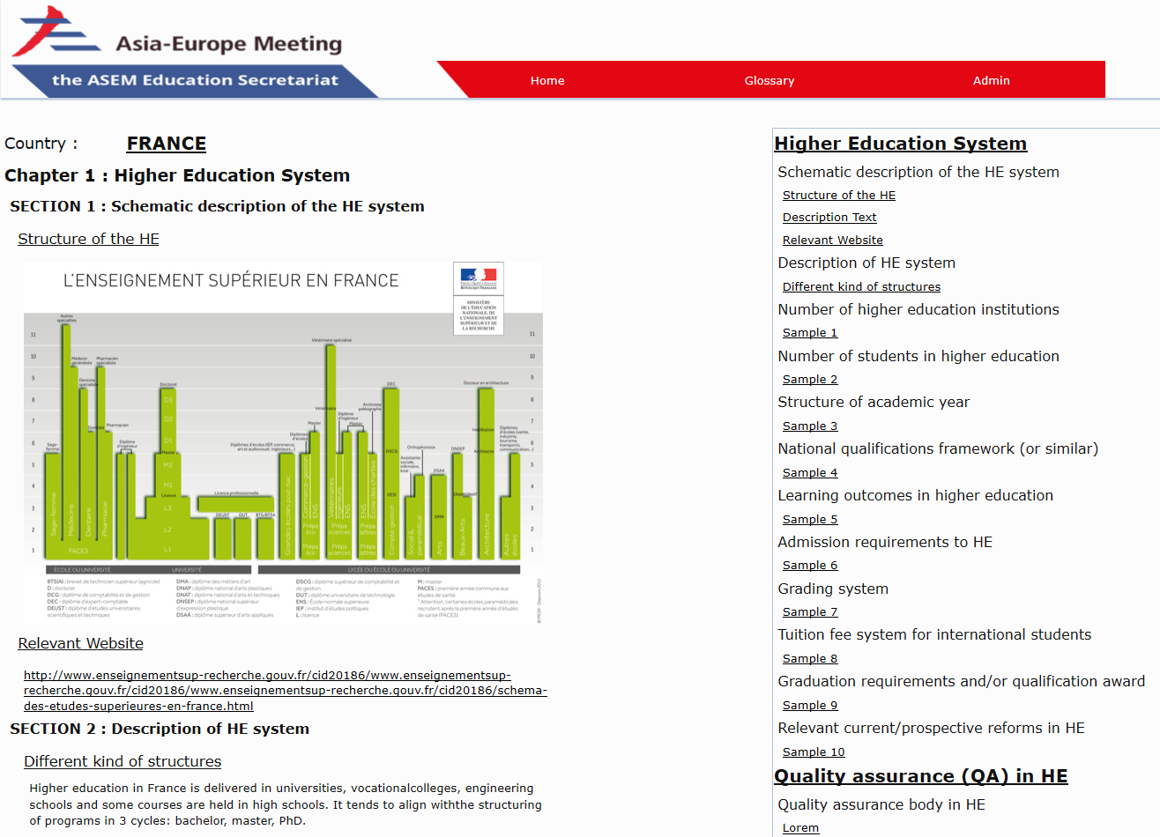
Compendium online tool

Slide 7
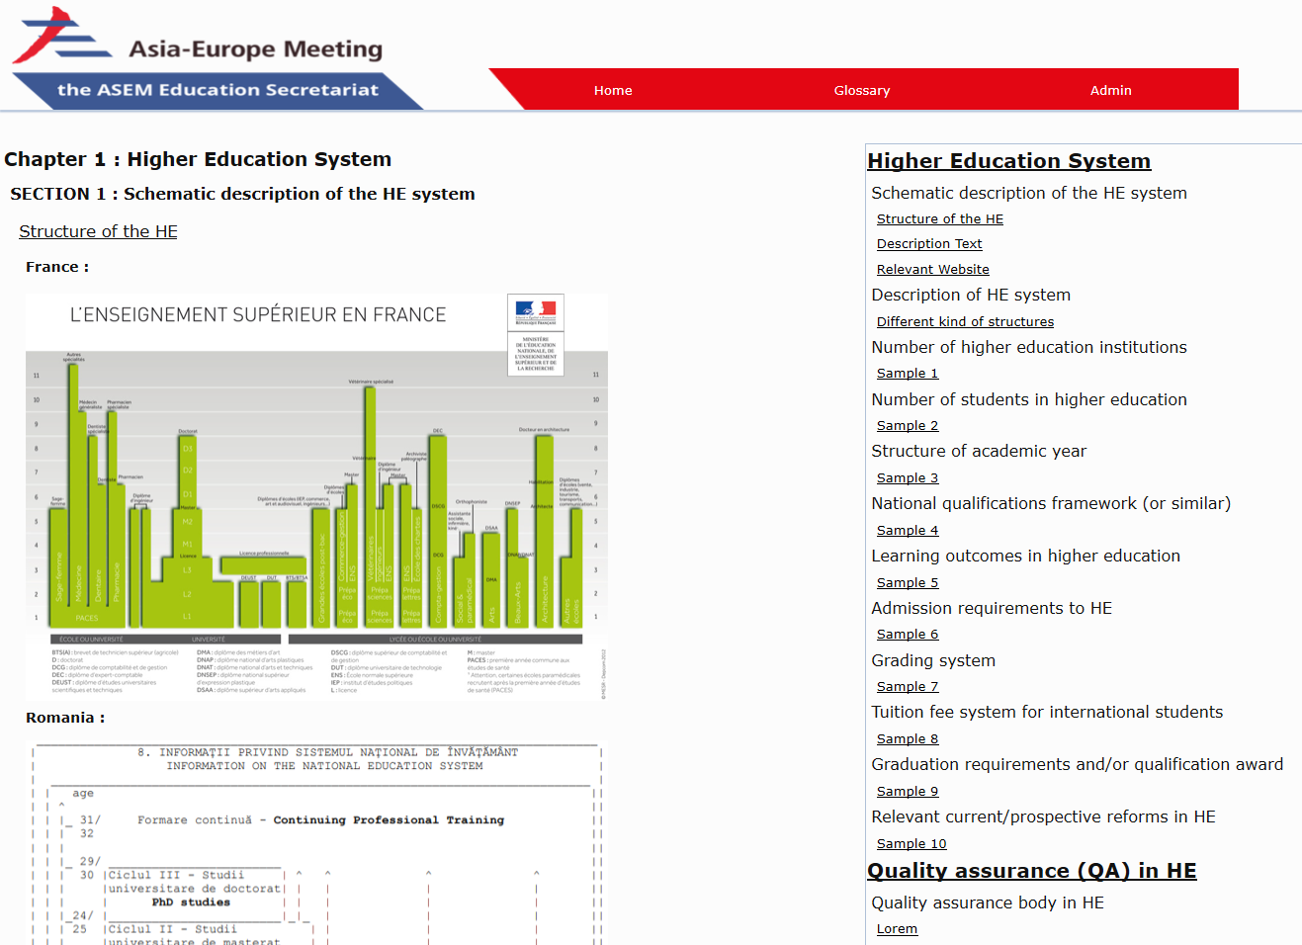
Compendium online tool

Slide 8
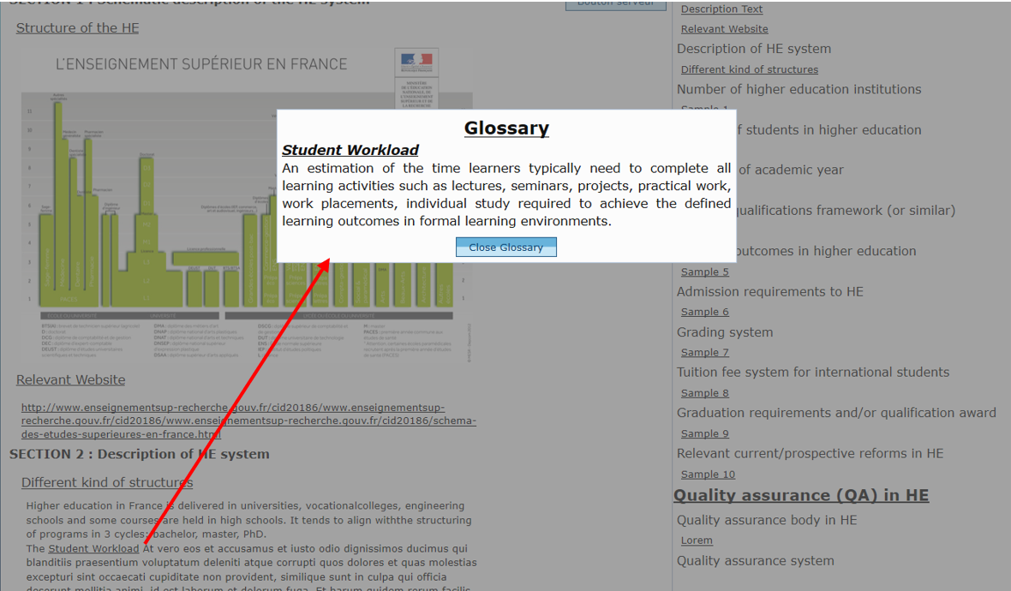
Compendium online tool

Slide 9
Thank you for your attention
Contact ASEM Education secretariat : info@asem-education.org
Expert group on Interregional Credit Transfer Mechanisms and Learning Outcome Systems
Phuket
28 March 2019

